Slide 1

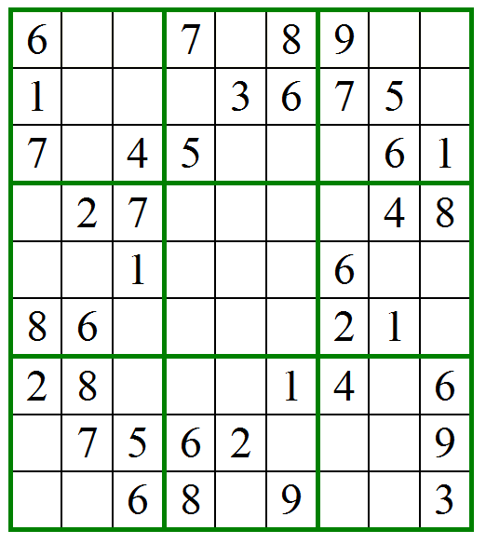
Accessible Sudoku
Team:
Kyle Morton
Roger Call
Inchara Shivalingaiah
Damon Alexander
Maria Pavlovskaia

Slide 3
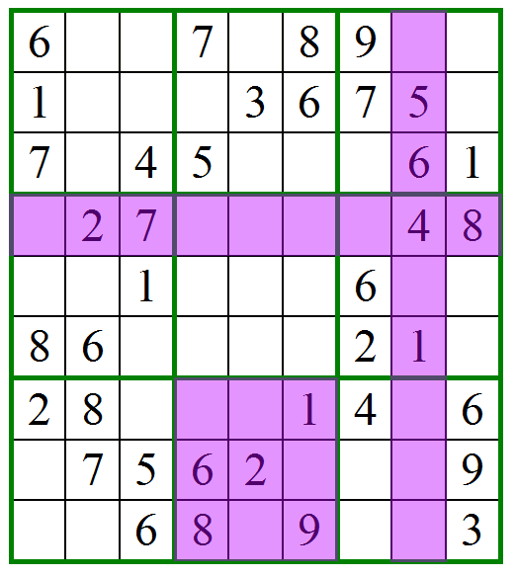

Slide 4
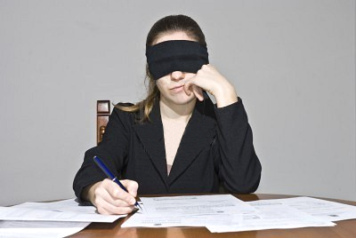
Challenges
Conceptualizing the board without seeing it

Slide 5
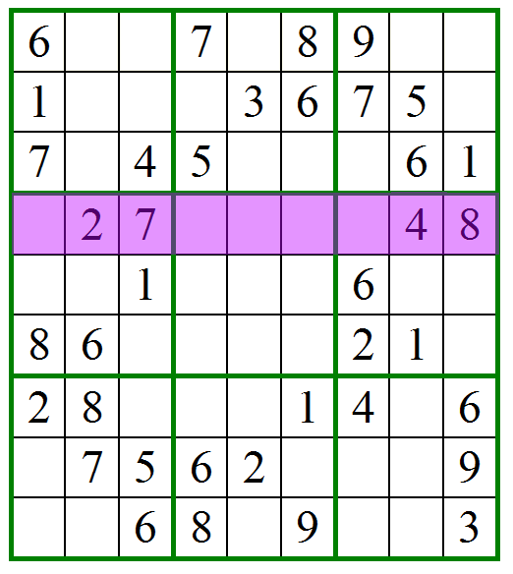
“Read Row 4”

Slide 6
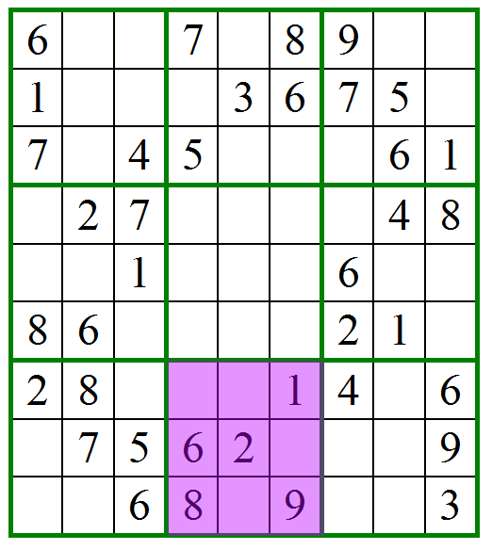
“What is missing from Box 8?”

Slide 7
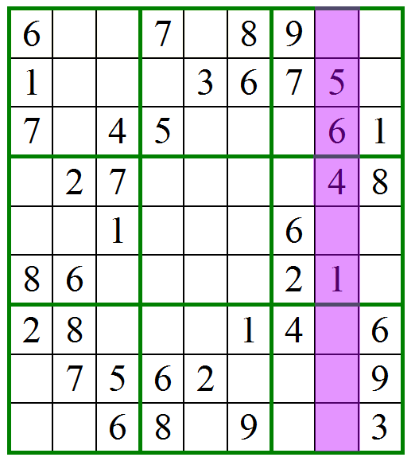
“Is there a 5 in Column 8?”

Slide 8
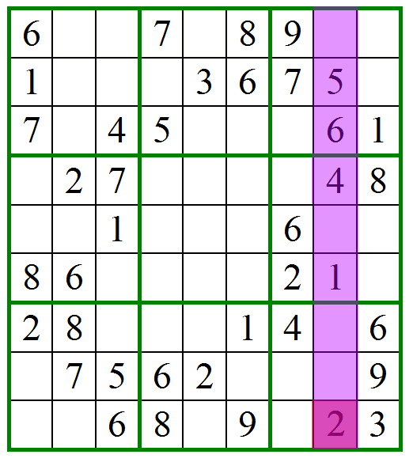
“Hint for Col 8”

Slide 9
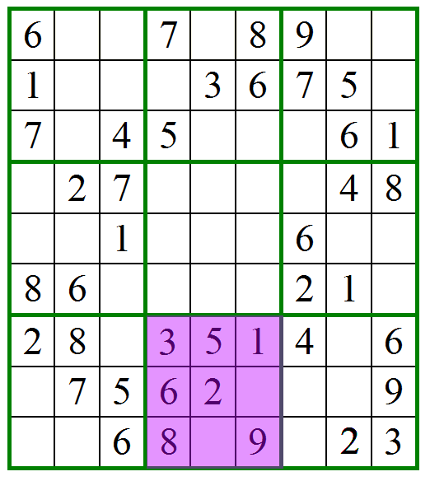
“Find Box with fewest missing”

Slide 10
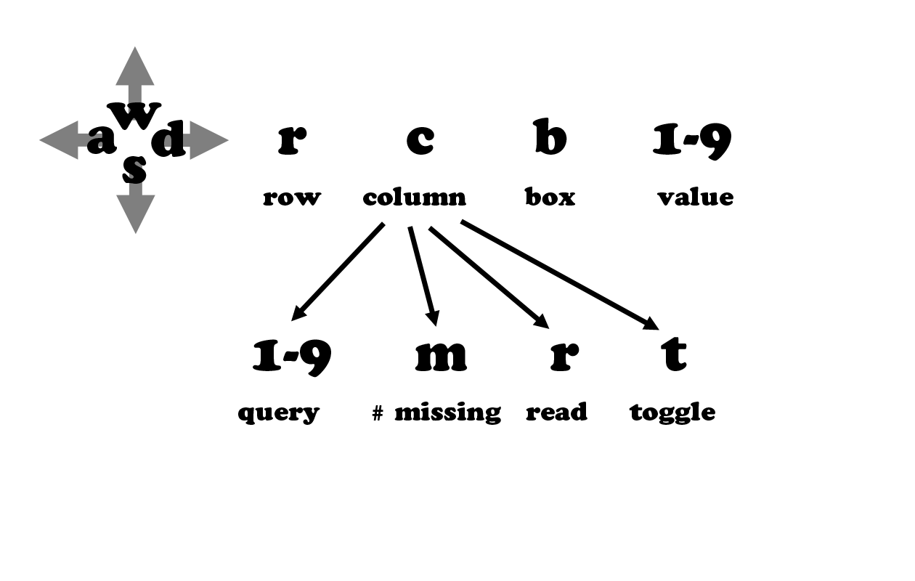
Control Scheme

